Slide 1
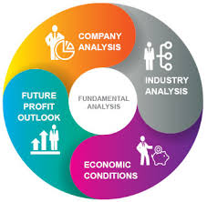
Fundamental Analysis

Slide 2

Meaning of Fundamental Analysis
It is a combination of economic, industry and company analyses to obtain a stock’s current fair value and predict its future value. Also called top-down approach or EIC(Economic, Industry and Company) analysis.

Slide 3
Stock value
Economy
Company
Industry

Slide 4

Economic Analysis
Economic Analysis is a study of the general economic factors that go into an evaluation of a security’s value. When economic activity is low , stock prices are low, and when the economic activity is high, stock prices are high.

Slide 5
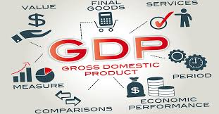
Macroeconomic factors
Gross Domestic Product
It represents the aggregate monetary value of the goods and services produced in the economy during the specified period.
GDP = Consumption + Investment + Exports – Imports
High GDP – High return
Low GDP – Low return & decline in economy.

Slide 6
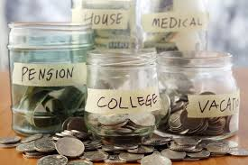
Savings and Investment
Growth in savings leads to more investments. High capital Investment leads to more production, more demand and supply, better prices in the future, higher business profit and a positive outlook for the stock market.

Slide 7
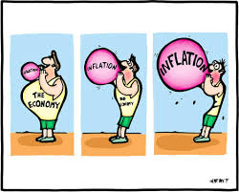
Inflation
  Inflation is a situation where too much money is chasing too few goods. It leads to increase in the price of goods and services. It results in:
  High raw material cost
  Non-availability of cheap credit
  Low earnings

Slide 8
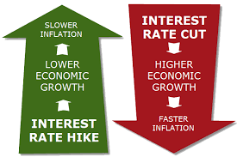
Interest rates
The base rate of banks affects the cost of borrowed funds. The base rate is the minimum rate of interest at which banks lend to anyone. It is influenced by RBI’s bank rate, repo rate and CRR.

Slide 9
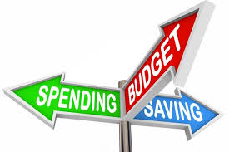
Budget
Budget provides a detailed account of government revenues and expenditures.
Deficit Budget – Increase in inflation, affect cost of production
Surplus Budget – Deflation
Balanced Budget – Highly favorable to stock market

Slide 10
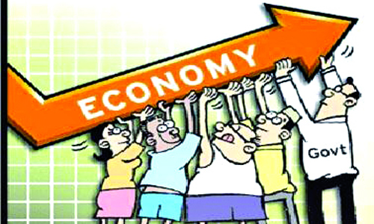
Fiscal Deficit
Fiscal Deficit = Government’s Total receipts(excluding borrowing) - Total expenditure.

Slide 11

Tax Structure
The business community eagerly awaits the statement from the government regarding the tax policy. Concessions and incentives given to a particular industry encourage investment in that particular industry.

Slide 12
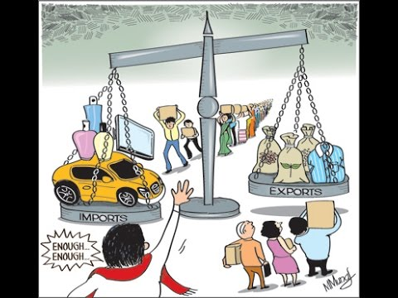
Balance of Payments(BOP)
It is the record of a country’s money receipts from abroad and payments to foreign countries.
BOP = Receipts – Payments
Favourable BOP has a positive effect on the stock market.

Slide 13
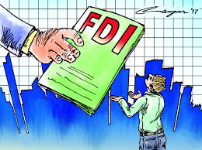
Foreign Direct Investment(FDI)
FDI in India is a major monetary source for economic development in India. Foreign companies invest directly in fast growing private Indian businesses to take benefit of cheaper wages and changing business environment of India.

Slide 14

Investment by Foreign Institutional Investors(FIIs)
A foreign institutional investor (FII) is an investor or investment fund registered in a country outside of the one in which it is investing. Institutional investors most notably include hedge funds, insurance companies, pension funds and mutual funds.

Slide 15
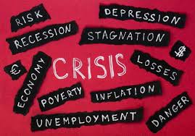
International Economic conditions
    Worldwide economies are not independent but interdependent. The boom or depression in one company affects other countries and the stock market.

Slide 16
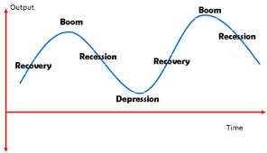
Business Cycle and Investor Psychology

Slide 17

Monsoon and Agriculture
In spite of technological advancements, Indian agriculture still depends heavily on the monsoon. Good monsoon are a boon for agriculture. Agriculture is directly or indirectly linked to many industries.

Slide 18
Favourable Monsoon | Unfavourable or failure of Monsoon
High demand for hybrid seeds, fertilizers, farm equipment,etc | Low demand for hybrid seeds, fertilizers, farm equipment, etc.
Bumper crops | Failure of harvest
High rural disposable income | Less rural disposable income
High rural demand for consumer goods, cars, etc | Less rural demand for consumer goods, cars, etc
Raw naterials

